Slide 1

PRESENTATION
Effectiveness of Ensemble Methods in Malware Detection
Mr H Chauke , Ms Moila

Slide 2
Ensemble Methods in Malware Detection

Slide 3
Introduction
The evolving malware threat, from viruses to ransomware and spyware, causes global security risks and financial losses.
Detecting malware has become complex due to hackers' advanced tactics. Research fosters innovative detection approaches, aiding our understanding of malware behavior and enabling timely security updates.
Ongoing research is essential to secure digital environments.

Slide 4
Problem Statement
The creation of sophisticated and constantly evolving malware poses a significant cybersecurity challenge, necessitating the development of robust and adaptive malware detection systems. Conventional single-classifier approaches often struggle to keep pace with the dynamic nature of malware, resulting in high false positive rates and missed detections.
To address this issue, this research aims to investigate the effectiveness of ensemble methods in improving the accuracy and resilience of malware detection systems.

Slide 5
Objective
To evaluate the performance of ensemble
methods.
Assess the effectiveness of ensemble methods, Like bagging, boosting, stacking, and voting ensembles, in enhancing the accuracy of malware detection.
On this research we will focus on bagging and boosting

Slide 6
Ensemble Methods
Ensemble learning involve sjoining multiple machine learning models into a single problem, and these models are typically referred to as weak learners. The underlying idea is that by uniting numerous weak learners, together they can collectively evolve into strong learners.

Slide 7
Random Forest Classifier
It leverages an ensemble of multiple decision trees to generate predictions or classifications. (“Random Forest® — A Powerful Ensemble Learning Algorithm,” n.d.)
By combining the outputs of these trees, the random forest algorithm delivers a consolidated and more accurate result.

Slide 8
Random Forest Classifier
Steps Involved in Random Forest Algorithm
Step 1: A subset of data points and a subset of features is selected for constructing each decision tree.
Step 2: Individual decision trees are constructed for each sample.
Step 3: Each decision tree will generate an output.
Step 4: Final output is considered based on Majority Voting or Averaging for Classification and regression, respectively.

Slide 9
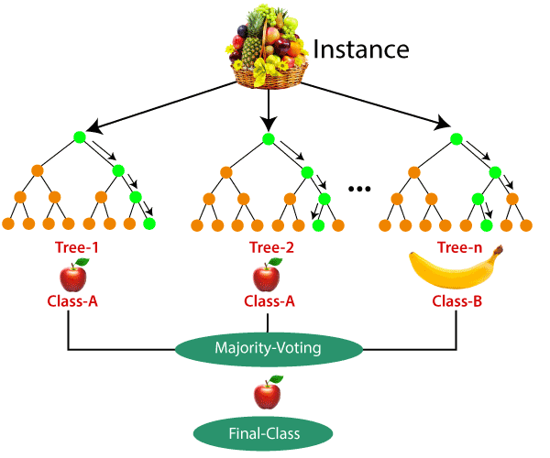
Example: Random Forest

Slide 10
Bagging
Bagging (Bootstrap Aggregation) is used to reduce the variance of a decision tree(“Ensemble Classifier | Data Mining - GeeksforGeeks,” n.d.)
Bagging takes random samples of data, builds learning algorithms, and uses the mean to find bagging probabilities. It’s also called bootstrap aggregating. Bagging aggregates the results from several models in order to obtain a generalized result. (Mwiti, 2022)
The method involves:
Creating multiple subsets from the original dataset with replacement,
Building a base model for each of the subsets,
Running all the models in parallel,
Combining predictions from all models to obtain final predictions.(Mwiti, 2022)

Slide 11
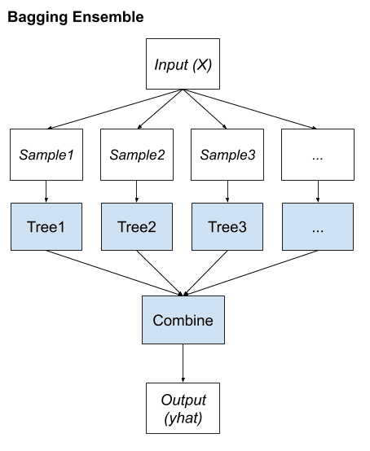
Example : Bagging Ensemble

Slide 12
Boosting
Boosting is an ensemble learning method that combines a set of weak learners into a strong learner to minimize training errors. In boosting, a random sample of data is selected, fitted with a model and then trained sequentially—that is, each model tries to compensate for the weaknesses of its predecessor. (“What is Boosting?,” n.d.)
Boosting methods are focused on iteratively combining weak learners to build a strong learner that can predict more accurate outcomes. As a reminder, a weak learner classifies data slightly better than random guessing. (“What is Boosting?,” n.d.)

Slide 13
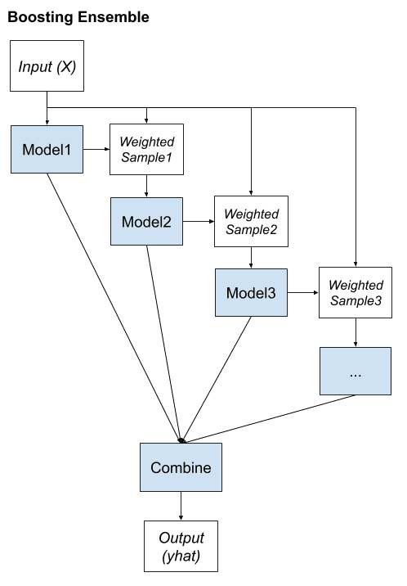
Example : Boosting Ensemble

Slide 14

Methodology

Slide 15
Google collab
Libraries: Colab offers access to a diverse array of Python libraries, including, but not restricted to:
Pandas and NumPy: For data manipulation and numerical operations.
Matplotlib and Seaborn: For data visualization and plotting.
scikit-learn: For various machine learning tasks such as classification, regression, and evaluation.
TensorFlow and PyTorch: For conducting deep learning and neural network experiments.
OpenCV: For handling computer vision tasks.
Natural Language Toolkit (NLTK) and spaCy: Useful for natural language processing.
SciPy: For conducting scientific and mathematical computations.
Other specialized libraries: Depending on the specific experiment, you may opt for libraries like XGBoost, LightGBM, or specialized deep learning libraries.

Slide 16
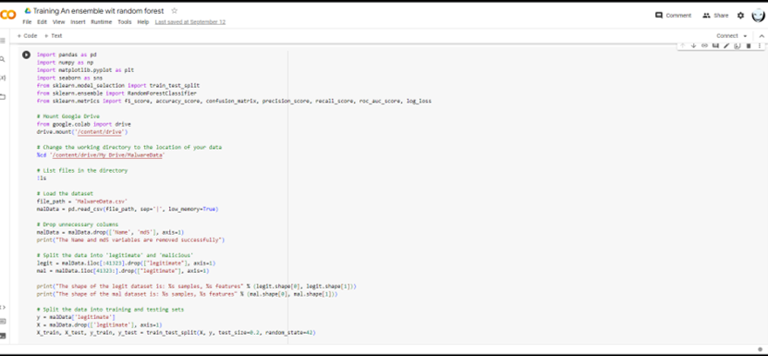
Google collab

Slide 17
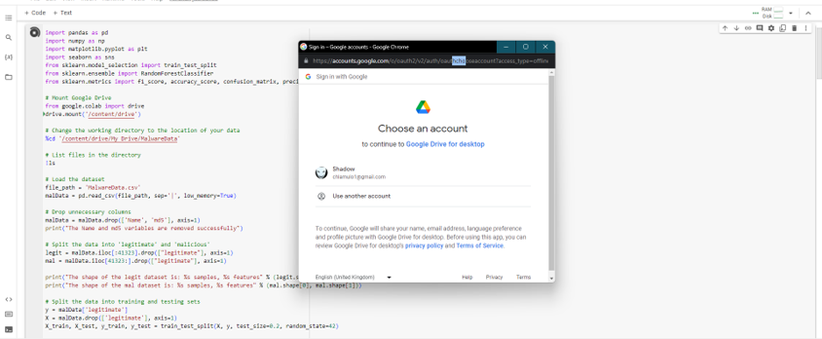
Google drive

Slide 18
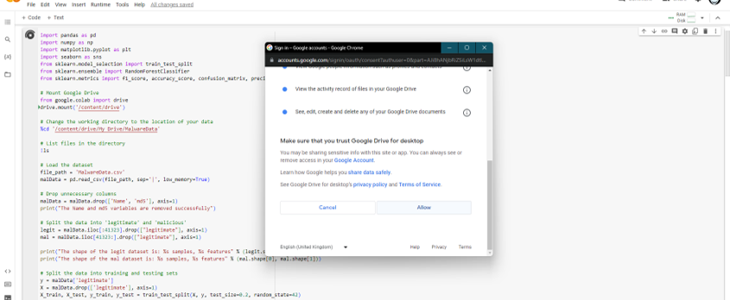
Google drive

Slide 19
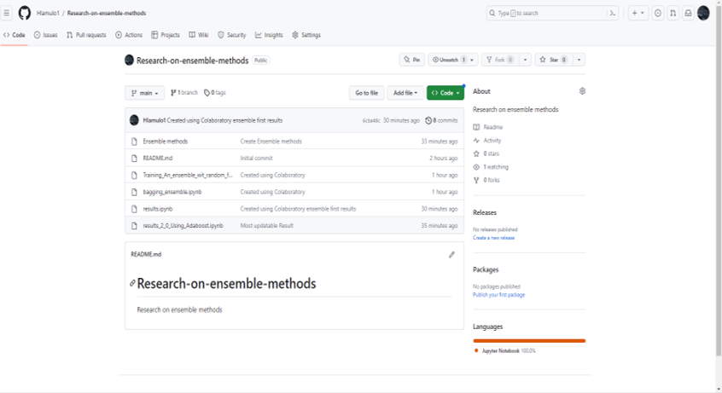
GitHub Repository

Slide 20

Performance Measures

Slide 21
Performance measures
Accuracy: quantifies the correctness of predictions by comparing the number of correctly predicted instances to the total instances in the dataset.
Recall (Sensitivity or True Positive Rate): Definition: Recall measures the model's ability to correctly identify actual positive cases, emphasizing the reduction of false negatives.
Precision: Definition: Precision gauges the accuracy of positive predictions, with a focus on minimizing false positives.
Confusion Matrix: Definition: A confusion matrix is a table used to assess a classification model's performance, providing a breakdown of predictions into true positives, true negatives, false positives, and false negatives.
F1 Score: Definition: The F1 score is the harmonic mean of precision and recall, finding a balance between the two

Slide 22
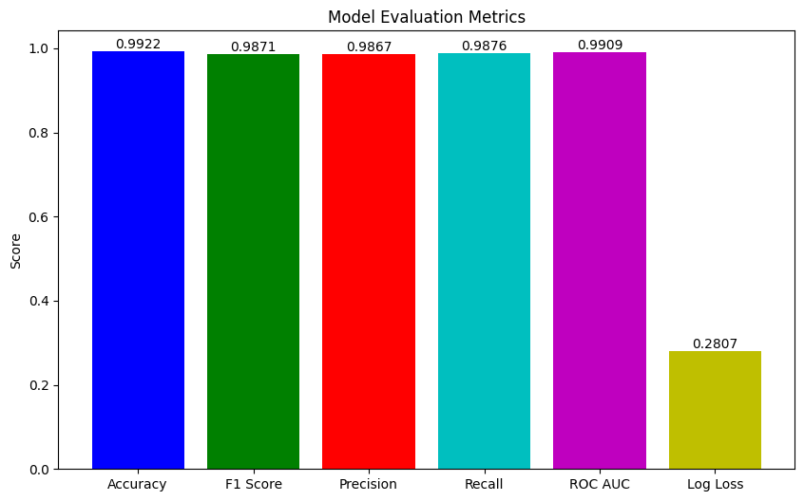
Decision Trees

Slide 23
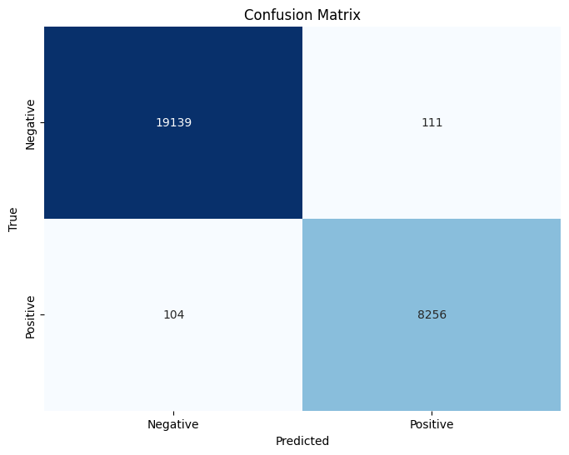
Decision Tree

Slide 24
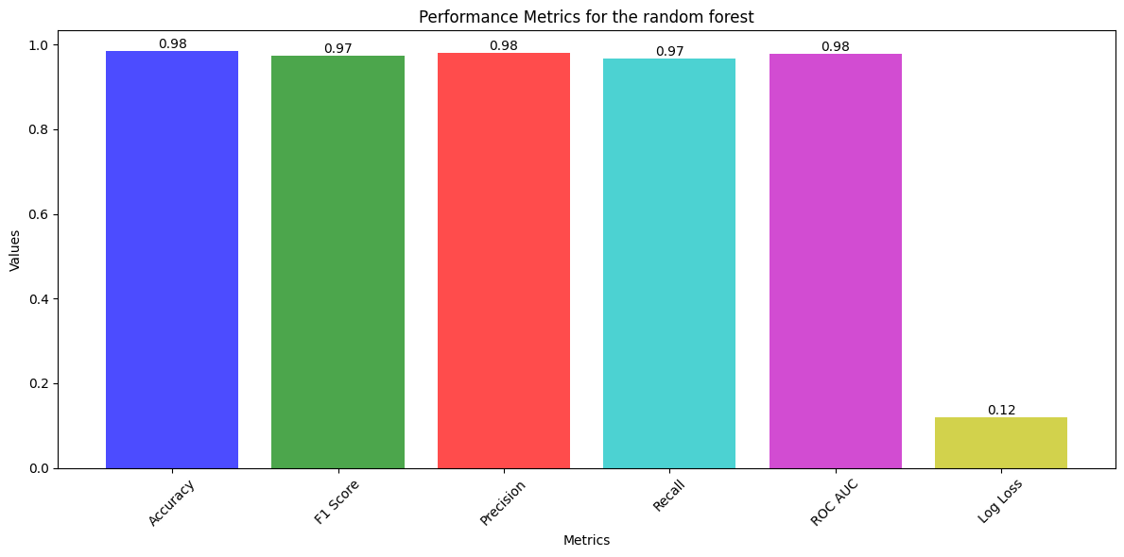
Random forest

Slide 25
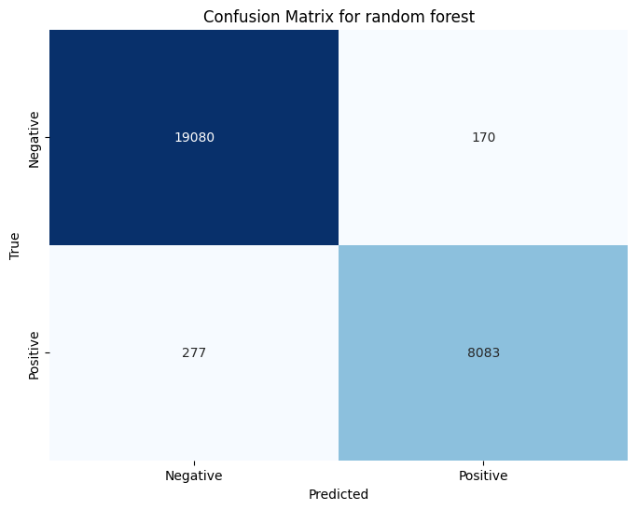
Random forest

Slide 26
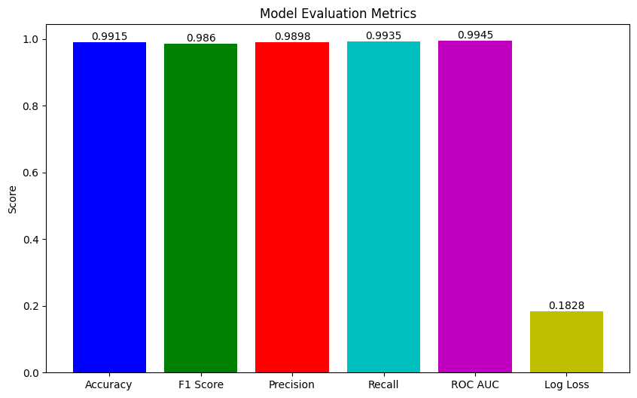
Boosting with Adaboost

Slide 27

Boosting with Adaboost

Slide 28
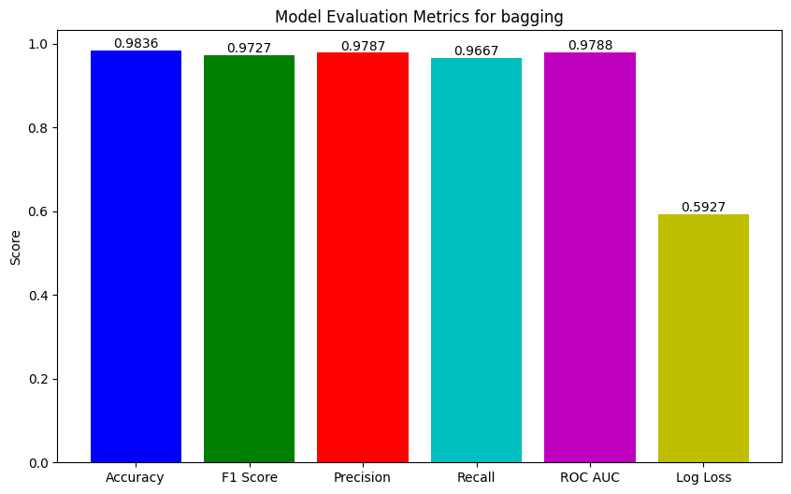
bagging

Slide 29

Bagging

Slide 30
Summarized metrics
 | accuracy | F1 score | precision | recall | ROC AUC | log loss
1.Decision Trees | 0.9922 | 0.9871 | 0.9867 | 0.9876 | 0.9909 | 0.2807
2. Random Forest ensemble | 0.98 | 0.97 | 0.98 | 0.97 | 0.98 | 0.12
3. Bagging ensemble | 0.9836 | 0.9728 | 0.9787 | 0.967 | 0.9789 | 0.5901
4. Adaboost boosting ensemble | 0.9915 | 0.986 | 0.9898 | 0.9935 | 0.9945 | 0.1828

Slide 31
Summarized confusion metrics
 | True negatives | True positives | Pred neg while positive | Pred pos while negative
Decision trees | 19139 | 8256 | 104 | 111
2. Random forest ensemble | 19080 | 8083 | 277 | 170
3. Bagging ensemble | 19074 | 8082 | 278 | 176
4. Adaboost Boosting ensemble | 19164 | 8306 | 54 | 86

Slide 32
References
Ensemble Classifier | Data Mining - GeeksforGeeks [WWW Document], n.d. URL https://www.geeksforgeeks.org/ensemble-classifier-data-mining/ (accessed 9.13.23).
Mwiti, D., 2022. A Comprehensive Guide to Ensemble Learning: What Exactly Do You Need to Know [WWW Document]. neptune.ai. URL https://neptune.ai/blog/ensemble-learning-guide (accessed 9.13.23).
R, S.E., 2021. Understand Random Forest Algorithms With Examples (Updated 2023). Anal. Vidhya. URL https://www.analyticsvidhya.com/blog/2021/06/understanding-random-forest/ (accessed 9.13.23).
Random Forest® — A Powerful Ensemble Learning Algorithm [WWW Document], n.d. . KDnuggets. URL https://www.kdnuggets.com/random-forest-a-powerful-ensemble-learning-algorithm.html (accessed 9.13.23).

Slide 33
References
What is Boosting? | IBM [WWW Document], n.d. URL https://www.ibm.com/topics/boosting (accessed 9.13.23).
Resources [WWW Document], n.d. . colab.google. URL http://0.0.0.0:8080/resources/ (accessed 9.13.23).
Machine Learning - Performance Metrics [WWW Document], n.d. URL https://www.tutorialspoint.com/machine_learning_with_python/machine_learning_algorithms_performance_metrics.htm (accessed 9.13.23).

Slide 34

I Thank you
Mr Chauke
(H)

